Slide 1
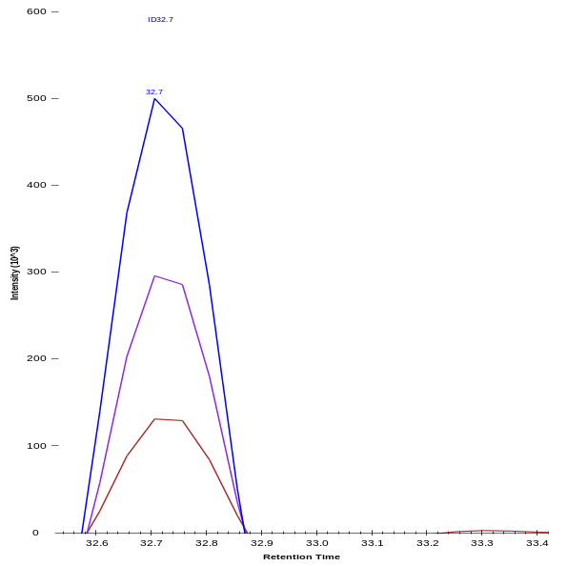
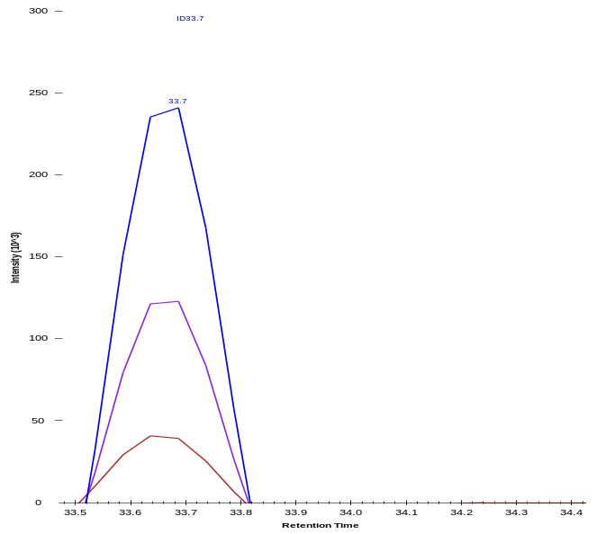
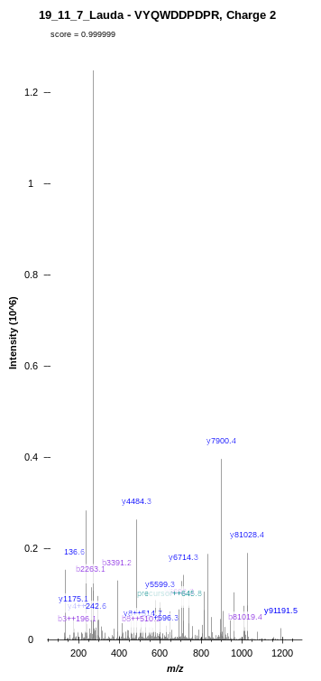
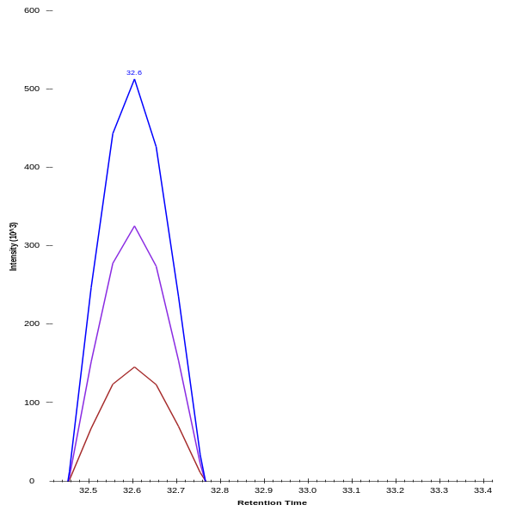
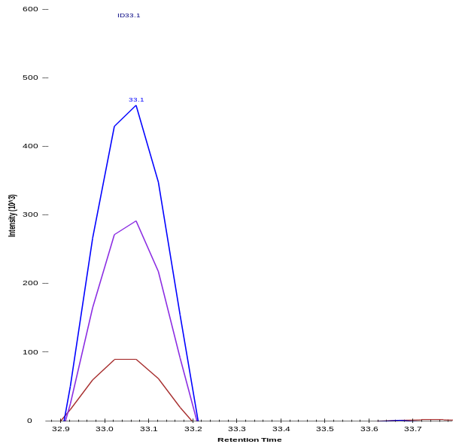
FASN
VYQWDDPDPR
Control
Vermentino
EtOH
Intensity
Intensity
MCF-7
Representative Spectra for FASN
VYQWDDPDPR
Retention Time
Retention Time
Vermentino
EtOH
Intensity (10^6)
Control
Intensity
Intensity
SKBR-3
m/z
Retention Time
Retention Time
Supplementary Figure 3

